Slide 1
Process Modeling
Chapter 6
(with additions by Yale Braunstein)

Slide 2

Key Definitions
A process model is a formal way of representing how a business operates
Data flow diagramming shows business processes and the data that flows between them

Slide 3
Key Definitions
Logical process models describe processes without suggesting how they are conducted
Physical models include information about how the processes are implemented

Slide 4
Data Flow Diagrams

Slide 5
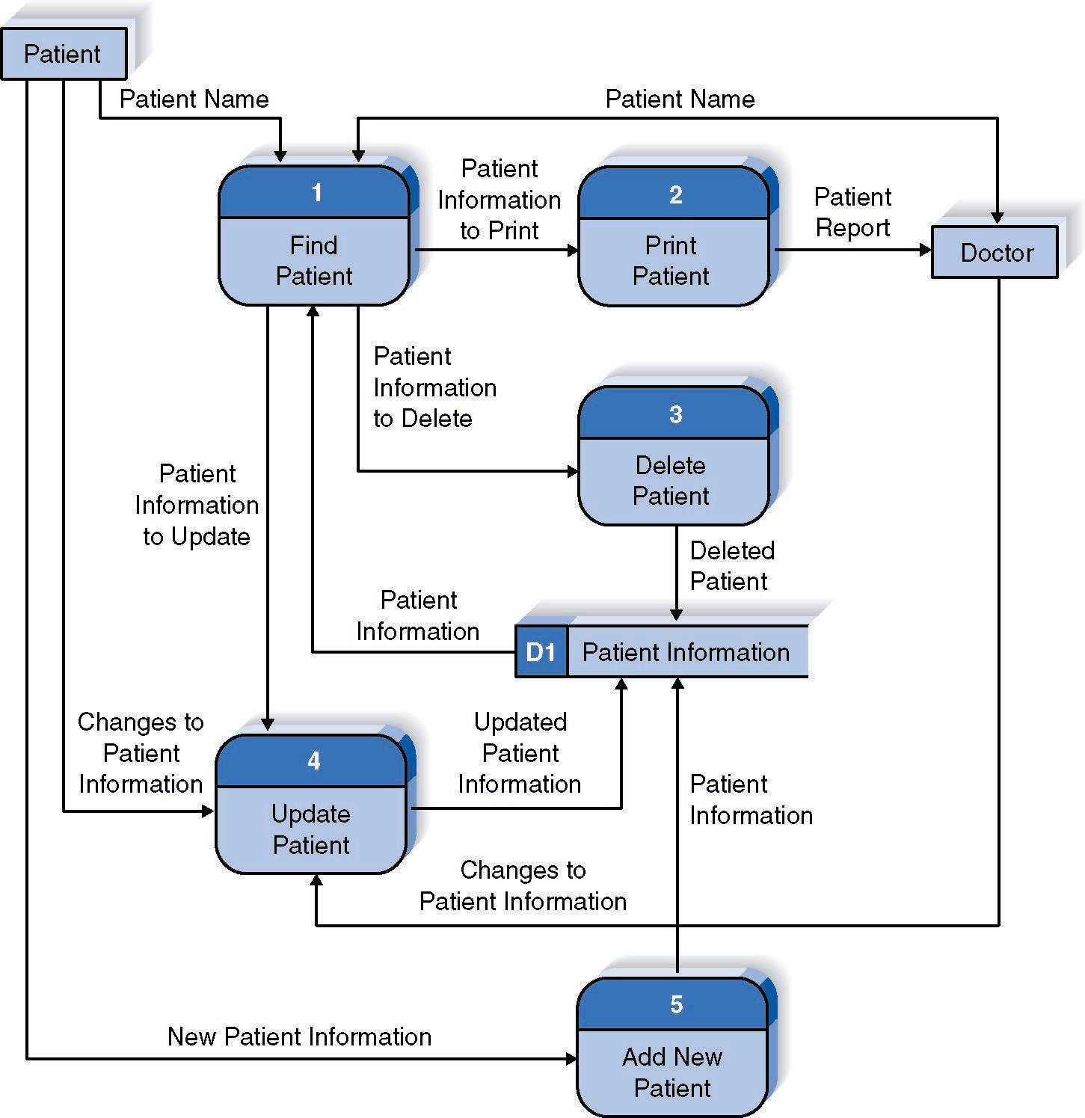
Reading a DFD

Slide 6
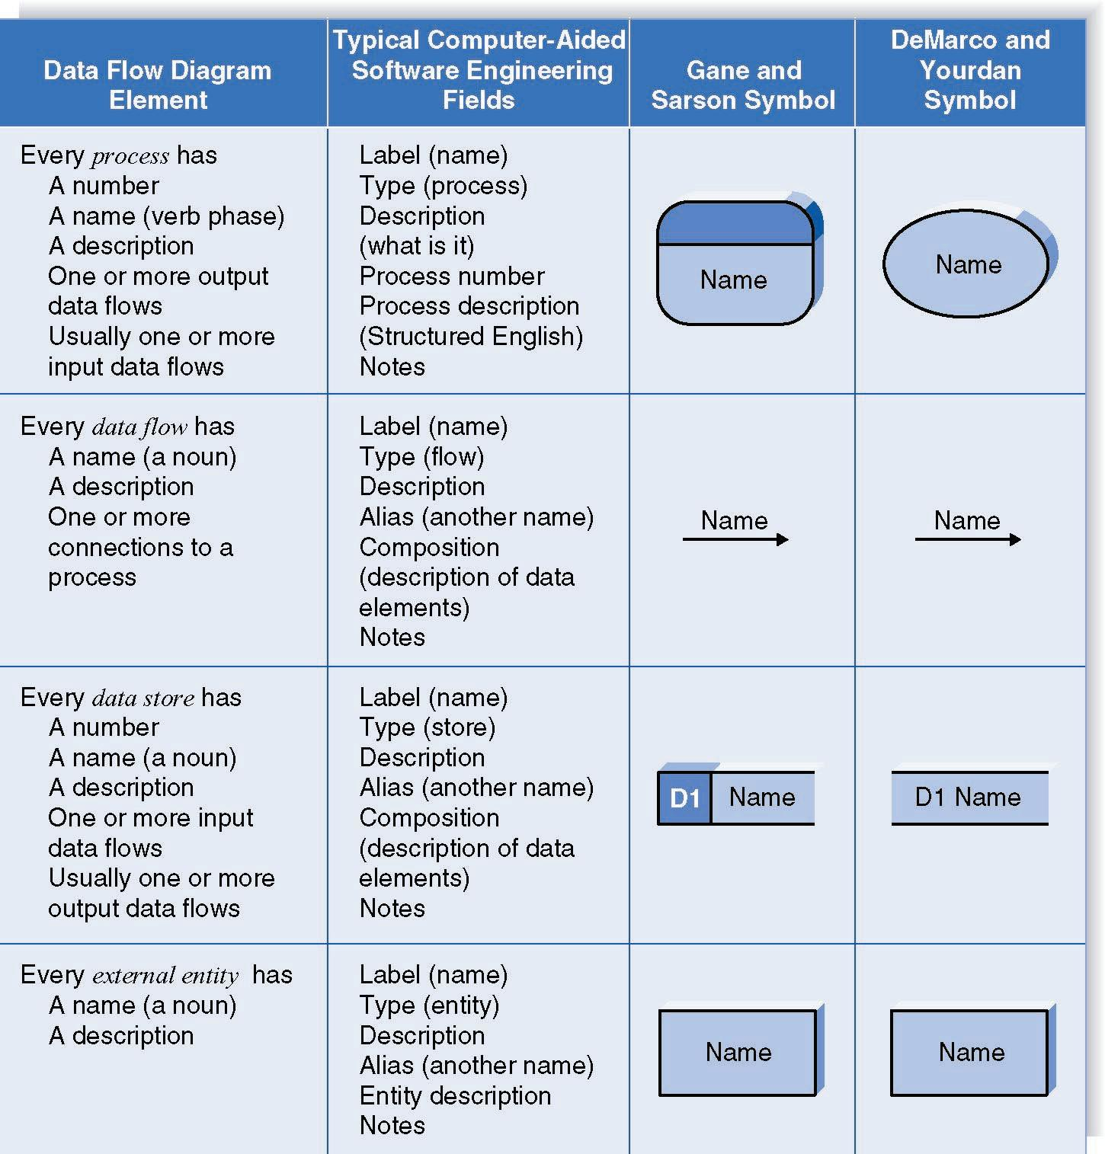
DFD Elements

Slide 7
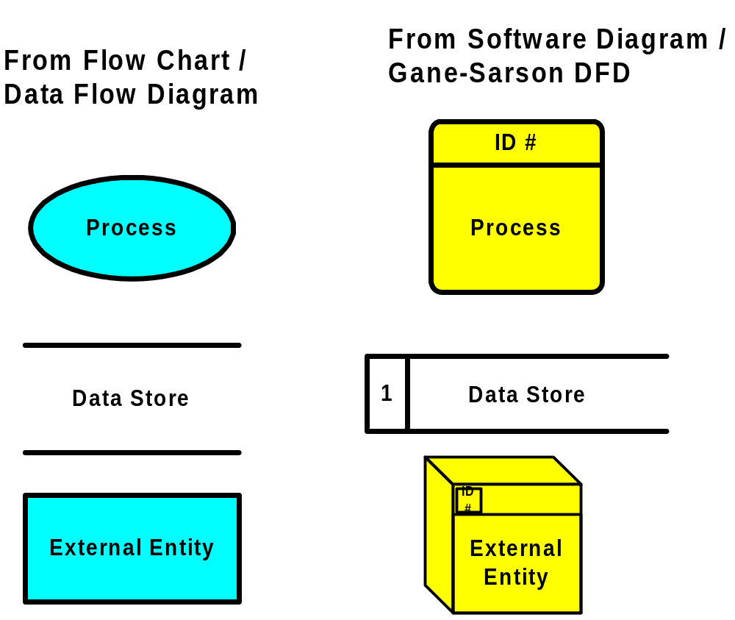
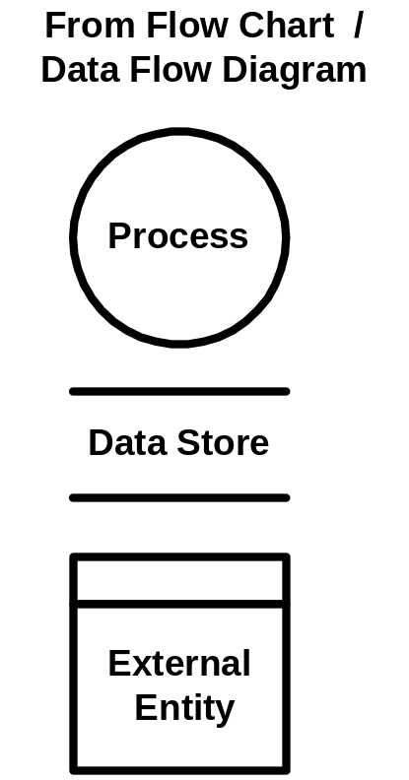
DFD Shapes from Visio
Visio 5.x
Visio 2000

Slide 8
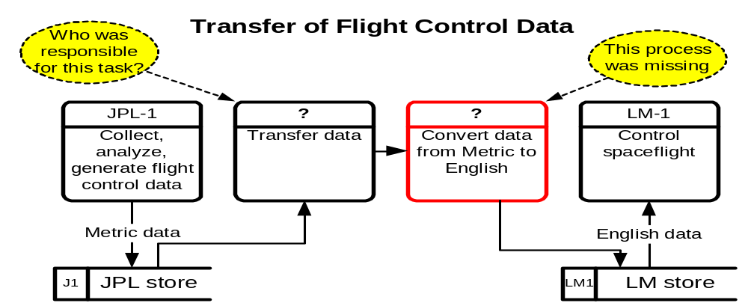
DFD – Practical Example
Launched Dec. 11, 1998, the Climate Orbiter plunged too steeply into the Martian atmosphere Sept. 23, 1999, and either burned up or crashed. In an initial failure report released Oct. 15, 2000 the review board blamed the navigation error on a communications foul-up between NASA's Jet Propulsion Laboratory and prime contractor Lockheed Martin.

Slide 9
Structured English
Common Statements Example
Action Statement Profits = Revenues - Expenses
Generate Inventory - Report
Add Product record to Product Data Store
If Statement IF Customer Not in Customer Data Store
THEN Add Customer record to Customer Data Store
ELSE Add Current-Sale to Customer’s Total-Sales
Update Customer record in Customer Data Store
For Statement FOR all Customers in Customer Data Store
Generate a new line in the Customer-Report
Add Customer’s Total-Sales to Report-Total
Case Statement CASE
If Income < 10,000: Marginal-tax-rate = 10%
If Income < 20,000: Marginal-tax-rate = 20%
If Income < 30,000: Marginal-tax-rate = 31%
If Income < 40,000: Marginal-tax-rate = 35%
ELSE Marginal-tax-rate = 38%
ENDCASE

Slide 10
Key Definition
Decomposition is the process of modeling the system and its components in increasing levels of detail.
Balancing involves insuring that information presented at one level of a DFD is accurately represented in the next level DFD.

Slide 11
Context Diagram
Shows the context into which the business process fits
Shows the overall business process as just one process
Shows all the outside entities that receive information from or contribute information to the system

Slide 12
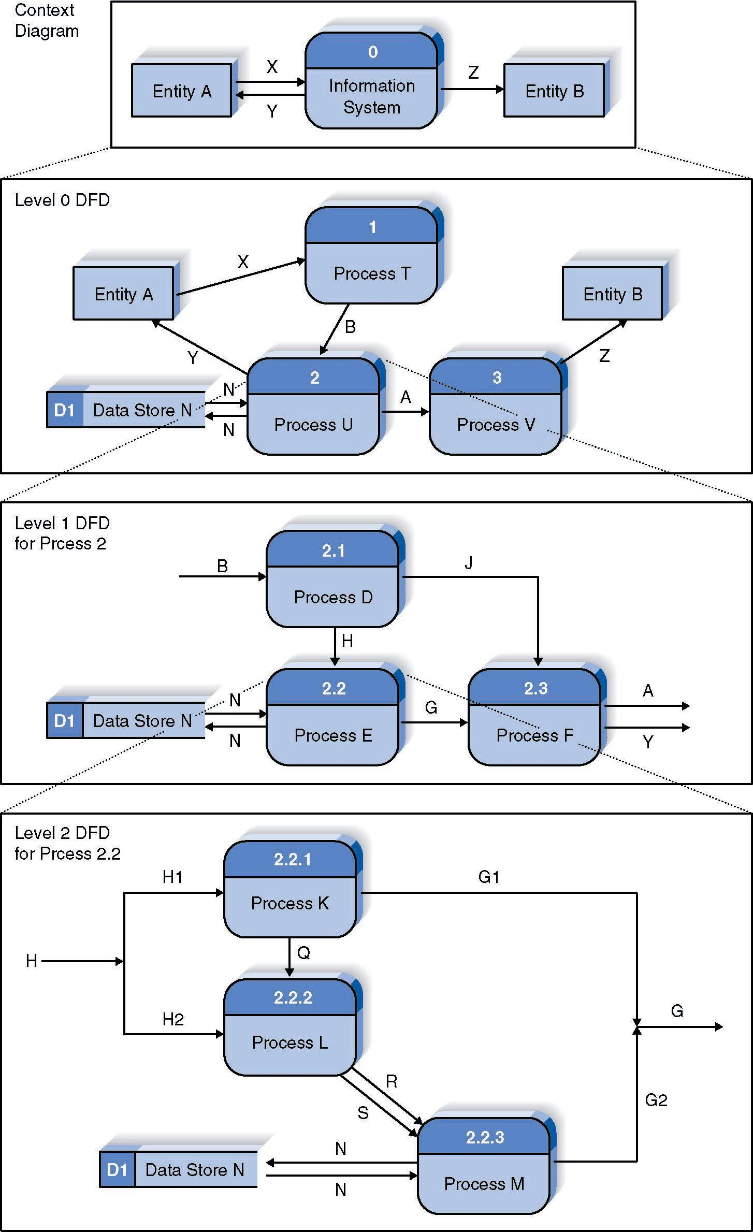
Relationship Among DFD levels

Slide 13
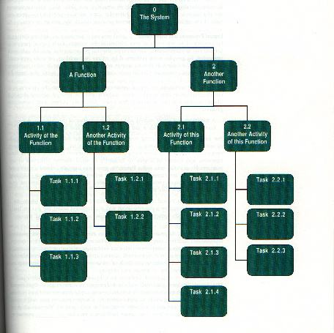
Decomposition Diagram

Slide 14
Level 0 Diagram
Shows all the processes that comprise the overall system
Shows how information moves from and to each process
Adds data stores

Slide 15
Level 1 Diagrams
Shows all the processes that comprise a single process on the level 0 diagram
Shows how information moves from and to each of these processes
Shows in more detail the content of higher level process
Level 1 diagrams may not be needed for all level 0 processes

Slide 16
Level 2 Diagrams
Shows all processes that comprise a single process on the level 1 diagram
Shows how information moves from and to each of these processes
Level 2 diagrams may not be needed for all level 1 processes
Correctly numbering each process helps the user understand where the process fits into the overall system

Slide 17
Data Flow Splits and Joins
A data flow split shows where a flow is broken into its component parts for use in separate processes
Data flow splits need not be mutually exclusive nor use all the data from the parent flow
As we move to lower levels we become more precise about the data flows
A data flow join shows where components are merged to describe a more comprehensive flow

Slide 18
Alternative Data Flows
Where a process can produce different data given different conditions
We show both data flows and use the process description to explain why they are alternatives
Tip -- alternative data flows often accompany processes with IF statements

Slide 19
Your Turn
At this point in the process it is easy to lose track of the “big picture”.
Describe the difference between data flows, data stores, and processes.
Describe in your own words the relationship between the DFD and the ultimate new application being developed.

Slide 20
Creating Use Cases

Slide 21

Elements of a Use Case
Trigger -- event that causes the scenario to begin
  External trigger
  Temporal trigger
All possible inputs and outputs
Individual steps
  Show sequential order
  Show conditional steps

Slide 22
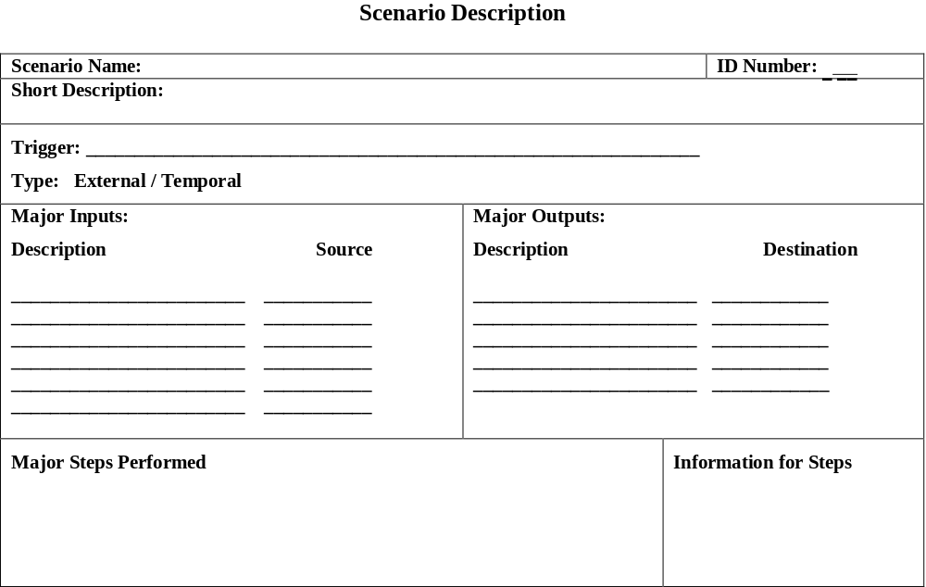
Scenario Template (Use Case)
This template can be downloaded from the course download page.
Slide <number>

Slide 23
Creating Data Flow Diagrams

Slide 24
Integrating Scenario Descriptions
DFDs generally integrate scenario descriptions
Names of use cases become processes
Names of inputs and outputs become data flows
Combining “small” data inputs and outputs into a single flow

Slide 25
Steps in Building DFDs
Build the context diagram
Create DFD fragments for each scenario
Organize DFD fragments into level 0
Decompose level 0 DFDs as needed
Validate DFDs with user

Slide 26
DFD Fragment Tips
All process names must be verb phrases
Maintain organization’s viewpoint in naming processes
Layouts often place
  processes in the center
  inputs from the left
  outputs to the right
  stores beneath the processes

Slide 27
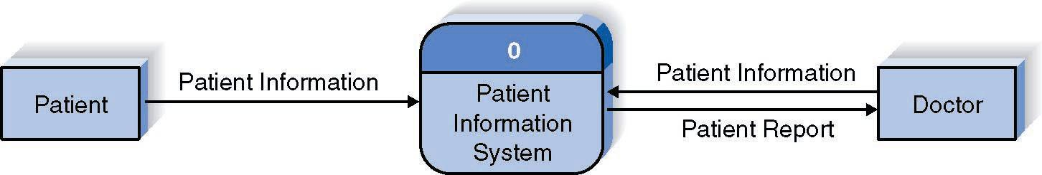
A DFD Fragment Example

Slide 28
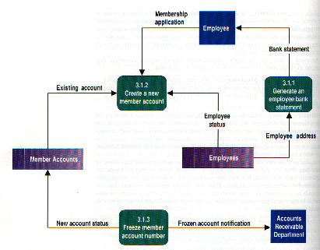
DFD – Common Errors
Black Hole
Gray Hole
Miracle

Slide 29
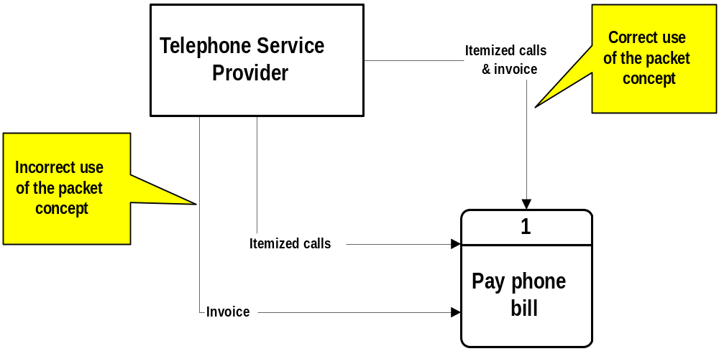
DFD – Packet Concept

Slide 30
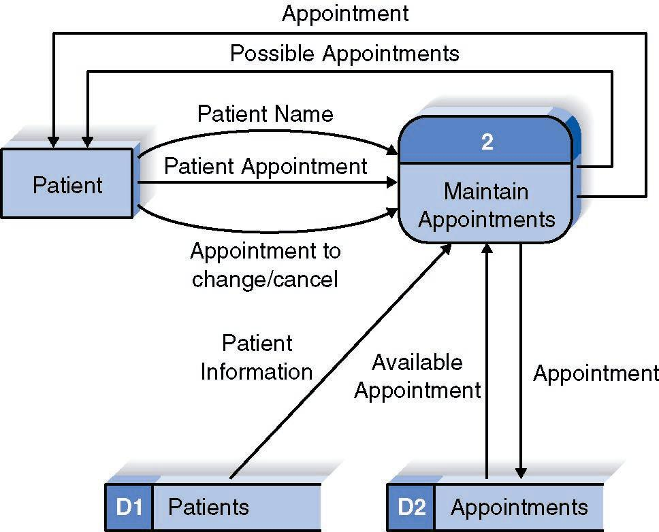
A Second DFD Fragment Example

Slide 31
Level 0 Tips
Generally move from top to bottom, left to right
Minimize crossed lines
Iterate as needed
  The DFD is often drawn many times before it is finished, even with very experienced systems analysts

Slide 32
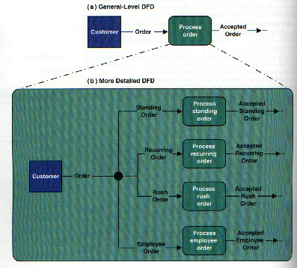
Composite & Elementary Flows

Slide 33
Tips for Level 1 and Below
Sources for inputs and outputs listed at higher level
List source and destination of data flows to processes and stores within each DFD
Depth of DFD depends on overall system complexity
  Two processes generally don’t need lower level
  More than seven processes become overly complex and difficult to read

Slide 34
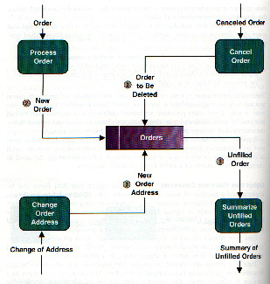
Flows to & from Data Stores

Slide 35
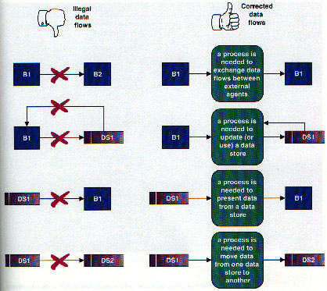
Illegal Data Flows

Slide 36
Validating the DFD
Syntax errors
  Assure correct DFD structure
Semantics errors
  Assure accuracy of DFD relative to actual/desired business processes
User walkthroughs
Role-play processes
Examine lowest level DFDs
Examine names carefully

Slide 37
More on Use Cases, Requirements, Projects

Slide 38
How should we gather requirements? Use cases?
1. Use cases hold functional requirements in an easy-to-read text format
2. They make a good framework for non-functional requirements & project details.
3. Use cases show only the Functional req’ts.
4. Design is not done only in use case units.

Slide 39
A use case collects related scenarios of a user’s goal succeeding or failing
UC 4: Place an order
Main scenario:
1. User identifies the customer, item and quantity.
2. System accepts and queues the order.
Extensions:
1a. Low credit: Customer is ‘Preferred’...
1b. Low credit & not Preferred customer: ...
2a. Low on stock: Customer accepts reduced...
Notes:
Why was this important?
It clarified our vocabulary and
It included all the parts we needed to function
Discuss other ways to write use cases
narrative
formal scripts

Slide 40
What sort of a use case fits your project: Fully Dressed, ...?
Use Case 12. Buy stocks over the web
  Primary Actor: Purchaser (user) Scope: PAF
  Level: user goal Precondition: User already has PAF open.
  Guarantees: sufficient log information exists that PAF can detect what went wrong.
  Success Guarantees: remote web site acknowledged purchase, user's portfolio updated.
  Main success scenario:
  1. User selects to buy stocks over the web.
  2. PAF gets name of web site to use (E*Trade, Schwabb, etc.)
  3. PAF opens web connection to the site, retaining control.
  4. User browses and buys stock from the web site.
  5. PAF intercepts responses from the web site, and updates the user's portfolio.
  6. PAF shows the user the new portfolio standing.
  Extensions:
  2a. User wants a web site PAF does not support:
  2a1. System gets new suggestion from user, with option to cancel use case.
  3a. ...

Slide 41
What sort of a use case fits your project:
..., Casual, ...?
Use Case: Buy something
  The Requestor initiates a request and sends it to her or his Approver, who completes the request for submission and sends it to the Buyer. The Buyer finds the best vendor, initiates PO with Vendor.
  At any time prior to receiving goods, Requestor can change or cancel the request. Canceling it removes it from any active processing.

Slide 42
What sort of a use case fits your project:
..., or Brief?
Actor
    Goal
Brief Description
Production Staff
Prepare digital cartographic source
Convert external digital data to standard format, validate & correct in preparation for merging with operational database.
...
...
...
Answer is, of course...
What are your project’s
Priorities and Communication Channels?

Slide 43
Use cases do not collect formulae, state, cardinality, performance, uptime, ...
Examples:
  1. Order cost = order item costs * 1.06 tax
  2. Promotions may not run longer than 6 months.
  3. Customers only become Preferred after ...
  4. A customer has one and only one sales contact.
  5. Response time is ...
  6. Uptime requirement is ...
  7. Number of simultaneous users will be ...
Capture those in any form available
(“just a tool problem”)

Slide 44
Goals make a good structure on which to hang requirements & project details.
Project planning capitalizes on goal structure:
  Useable Releases.
  Priorities,
  Schedule, staffing
Name P. Actor Pr. Diff. Rel Tm
Update customer Customer high med 1 ..
Generate invoice Finance high high 3 ..
Funds transfer Finance med high 4 ..
Scan products Customer high high 1 ..

Slide 45
Use the scenarios directly to Design and Test the system.
What if...?
Scenarios
“Knows how to...”
“Knows how to...”
“Knows how to...”

Slide 46
Summary
The Data Flow Diagram (DFD) is an essential tool for creating formal descriptions of business processes and data flows.
Use cases record the input, transformation, and output of business processes.
Eliciting scenario descriptions and modeling business processes are critically important skills for the systems analyst to master.

